Slide 1
Campus Green Space
Undergraduate Student Government Senate – Jack Sayre

Slide 2

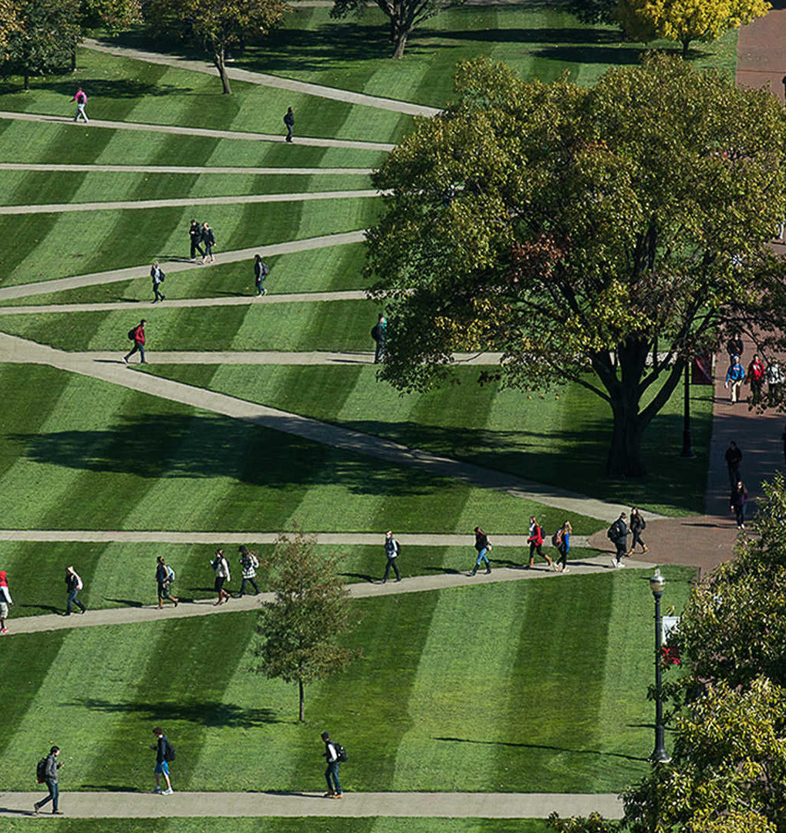
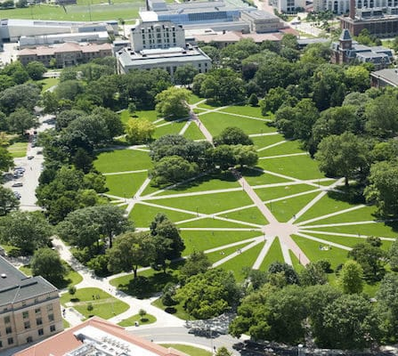
Project Description
Comparing the amount of green space per person in 2022 vs 1980 counting all enrolled students
•Students - Undergraduate and Graduate students
•Green Space - Any outdoor plottable segment of grass or field
•Green Space User - Any students who may use the green spaces for any purpose other than walking between locations

Slide 3
Insights
1980: 0.41 mi² of green space, 56,637 students, 205 sq ft²/student
2022: 0.36 mi² of green space, 62,576 students, 161 ft²/student
2022 weighted: 0.94 sq mi² of green space, 21,870 active users, 463 ft²/student
Results: since 1980, enrollment increased 22.02%, green space decreased 3.05%, and greenspace/student decreased 20.89%.
COVID: if students follow COVID regulations (staying 6ft apart), all the 2022 students can easily fit on campus green space given 36 ft² as space, there's a space between students, and green space is contiguous
 | All Online | Partially Online | All In-Person
On Campus | 6007/(40%) | 12755/(55%) | 1262/(95%)
Off Campus | 12766/(15%) | 27105/（30%） | 2681/（45%）
 | All Online | Partially Online | All In-Person
On Campus | 2403 | 7016 | 1198
Off Campus | 1915 | 8132 | 1206

Slide 4
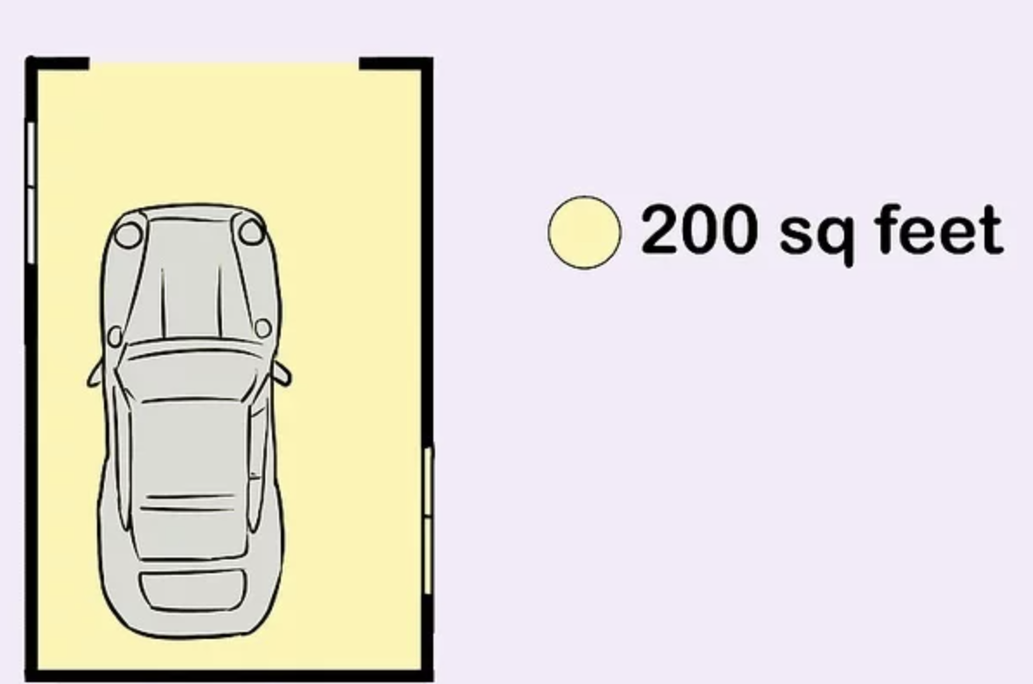
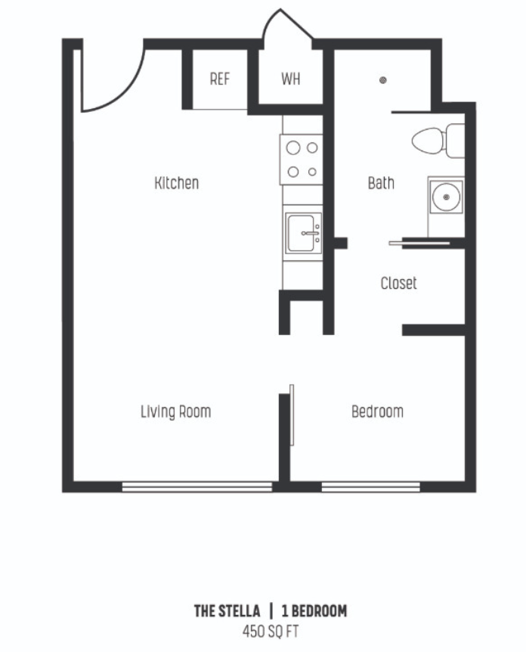
Insights
2022 green space => 161. ft²
Green space in campus that students can use per person is about like one-car garage size
2022 weighted green space => 462 ft²
Green space in campus that students can use per person is about like one bedroom apartment.

Slide 5
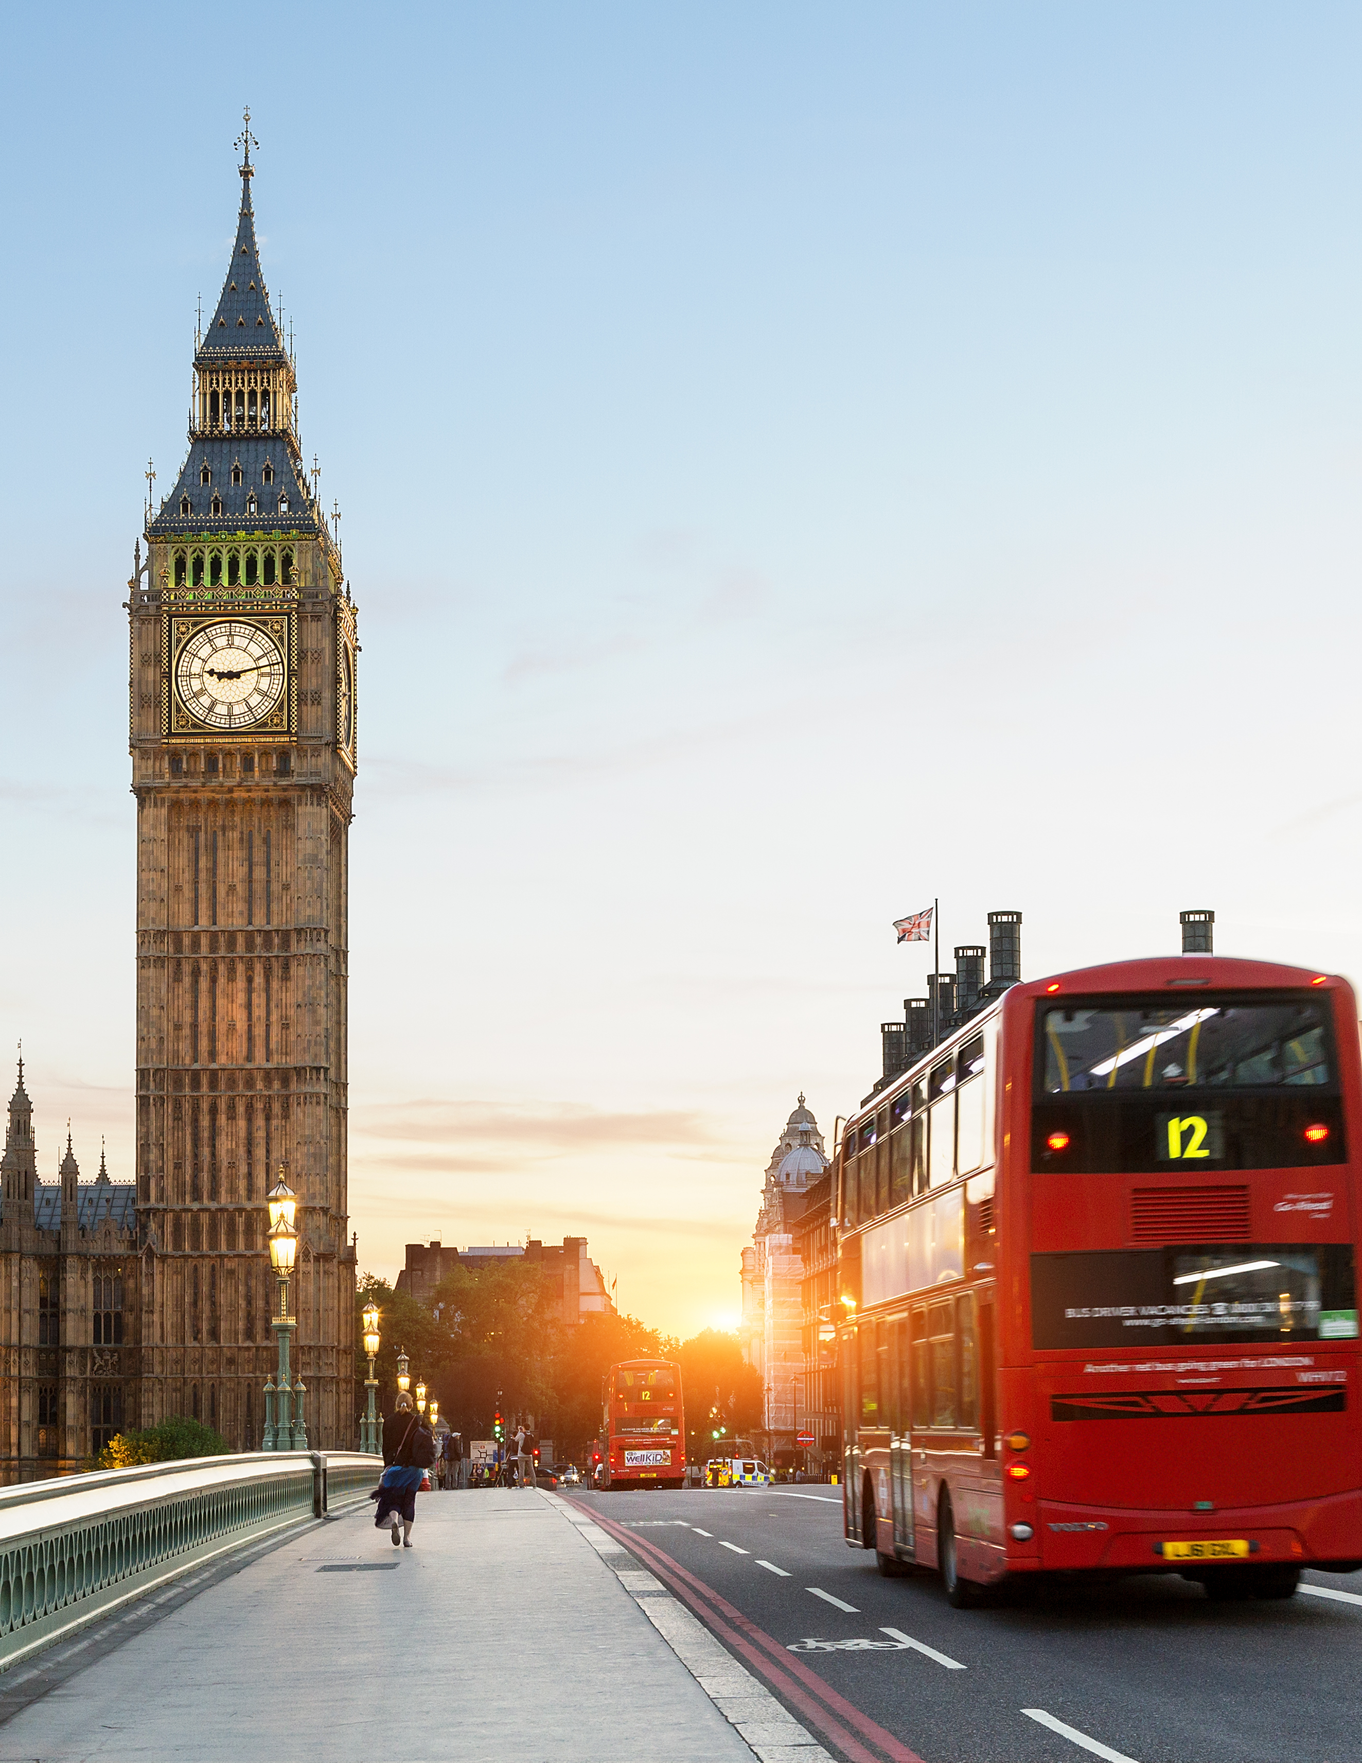
Insights
The population density of the London, UK is 2190 people/mi² while OSU is 3,527 people/mi²
Divide the population density by green space/person; receive values of 115.08 (London) and 185.34 (OSU)
Represents the green space density in the OSU campus and London city area
The population density of University of Michigan Ann Arbor is 3,691.4 people/mi² which is less than the population density of Ohio State. This most likely due to University of Michigan having less students enrolled in their school compared to OSU

Slide 6
Next Steps
Analyze green space per person in cities across the world and find answers to:
Does additional green space/person contribute to overall resident happiness?
Do cities with more green space have a younger population?
What motivates city planners to implement more green space, and can those same ideas motivate OSU leadership?
How feasible is adding more green space in most US cities?
Calculate green space/student at other large universities and ask:
How does OSU compare to universities of a similar geographic size?
Are OSU's numbers impressive enough to incentivize students to attend OSU over other universities?

Slide 7
Appendix
[ARCHIVED CONTENT] UK Statistics - Population and migration - ONS (nationalarchives.gov.uk)
https://www.collegetuitioncompare.com/online/ohio-state-university-main-campus/
https://www.usnews.com/best-colleges/ohio-state-6883/student-life
Green Space Index | Fields in Trust
Ohio_State-Statistical-Summary-2021_2022_v2.pdf (live-facts-osu.pantheonsite.io)
https://www.univstats.com/colleges/university-of-michigan-ann-arbor/student-population/
https://www.wikihow.com/Visualize-Square-Feet

